Slide 1
Hand gesture recognition for educational and patient recovery application
Student: Iancu Paul
Supervisor: S. l. Dr. Ing. Razvan ITU

Slide 2
Contents
Introduction
Motivation
Solution description
Results
Technologies used

Slide 3
Introduction
Hand Gesture Recognition is a hot topic in Human Computer Interaction (HCI)
Can be used for multiple purposes (e.g.: sign language recognition, UI interaction, video games, etc.)
It is a more intuitive method of interaction than regular keyboard and mouse methods

Slide 4
Motivation
Implement a solution that
Requires minimum hardware
Robust
Has real-time capabilities
Rotation and scale invariant
A prototype that uses our implemented solution
Application for educational purposes

Slide 5
Solution description
Steps of the algorithm:
Histogram equalization
Hand extraction
Distance transform
Palm point
Palm radius
Palm mask points
Wrist points
Rotation
Palm mask
Fingers extraction
Fingers’ lines
Fingers’ status

Slide 6
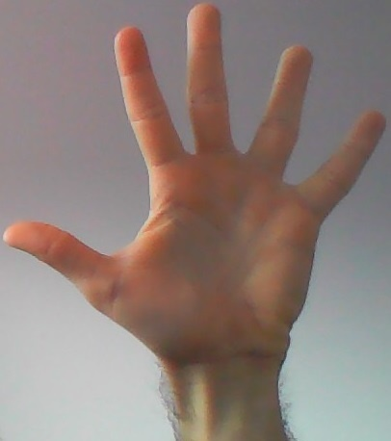
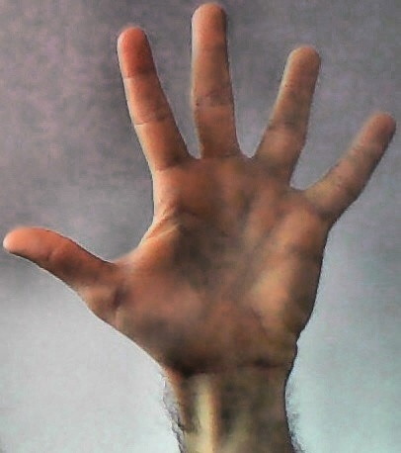
Histogram equalization
Used for eliminating brightness problems
Convert image from RGB space to HSV space
Extract image of only the value channel
Apply the CLAHE algorithm for performing histogram equalization on the value channel
Convert from HSV space back to the RGB space

Slide 7

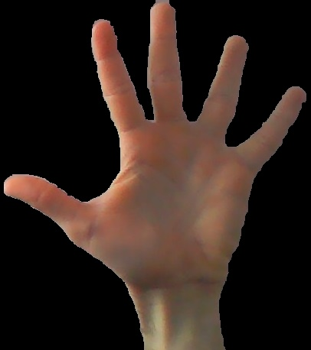
Hand extraction
Extract hand from background
Convert from RGB space to HSV space
Perform HSV filtering
Keep only the values within a given range for each channel

Slide 8
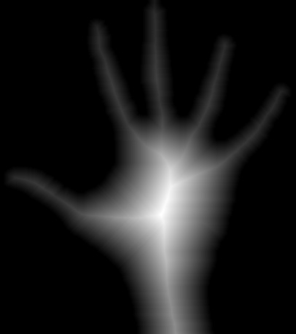
Distance transform
Get the distance transform of the contour of the extracted hand

Slide 9
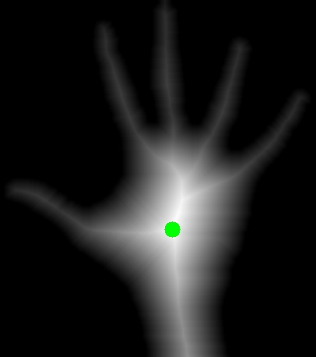
Palm point location
Use the distance transform to get the location of the palm center (palm point)
The point in the distance transform with the maximum value

Slide 10
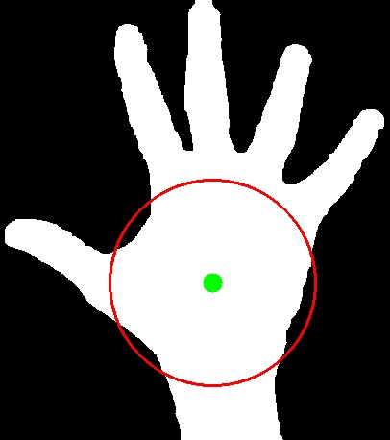
Palm radius
The radius in which the palm region of the hand is expected to be
Get the closest point on the contour of the hand from the palm point

Slide 11
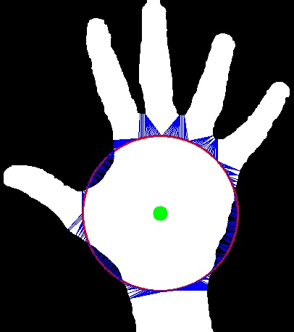
Palm mask points
Get the points that represent the contour of the palm region of the hand
Get sample points from the palm radius circle
For each angle in the interval [0; 360] with increment 1 degree, get the respective point on the palm radius center
For each sampled point get the closest point on the hand contour (palm mask point)

Slide 12
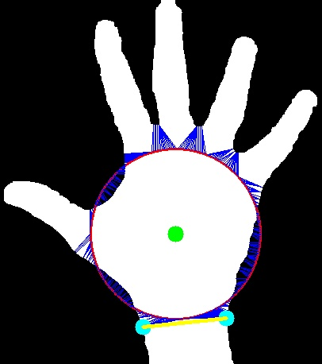
Wrist points
Get the pair of consecutive palm mask points that have the greatest distance between them (wrist points)

Slide 13

Rotate image
Rotate the image so that the line defined by the two wrist points is horizontal and cut of the portion of the image below the wrist line

Slide 14


Finger extraction
Get the palm mask (fill the polygon formed by the palm mask points) and apply it to the rotated hand image

Slide 15
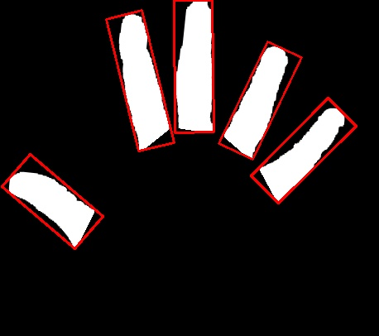
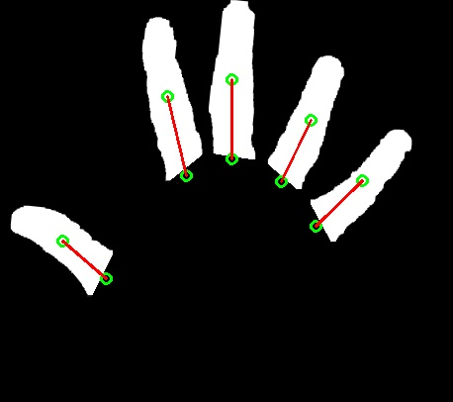
Finger lines
Get the connected components that represent each finger
Get the bounding box of each finger
Get the center and bottom of a finger and take the line as the orientation of the finger

Slide 16
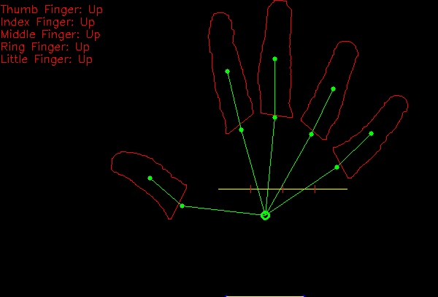
Finger status
Identify thumb finger, if it exists (checks if a finger’s center makes an angle of 50 degrees or less with the wrist line)
Get palm line (line with maximum length from the palm region)
Divide the palm line in 4 equal regions (one for each finger except the thumb)
Classify each finger based on
which region its bottom
point falls onto

Slide 17
Results
On 1000 test images gathered from my web camera, an accuracy of 95% classification was achieved
For testing the solution’s real-time capabilities, a sample video was recorded and used for testing
In the current implementation, a performance of 15 FPS was achieved
Will implement a multi-threaded version for achieving greater performance
Other optimization techniques will be applied

Slide 18
Technologies used
Python 3.7
OpenCV
NumPy
SciPy

Slide 19
Thank you!

